Slide 1
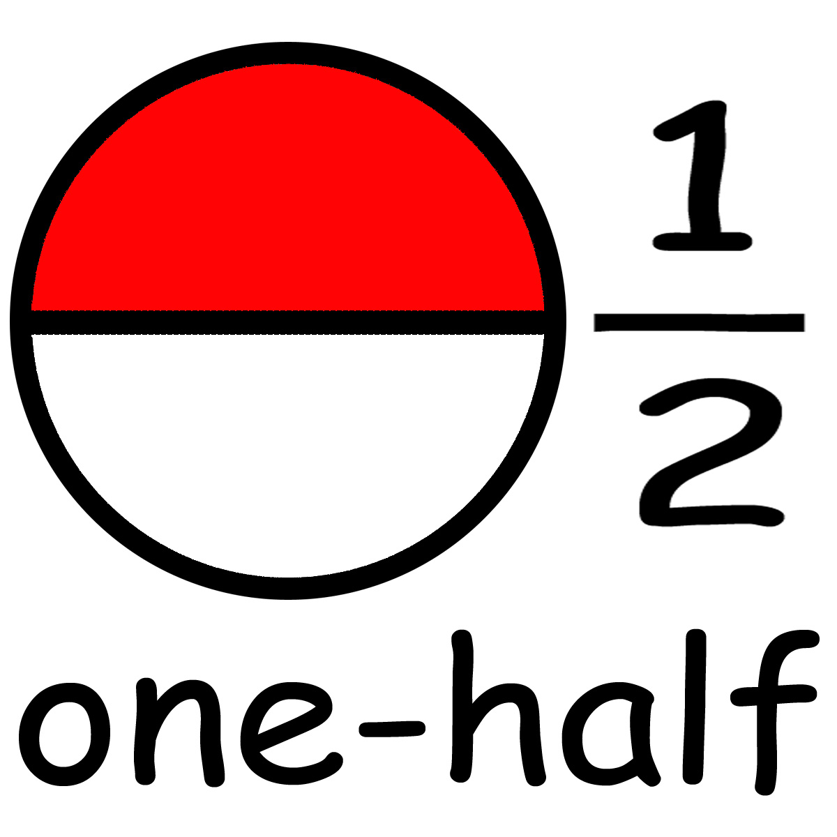
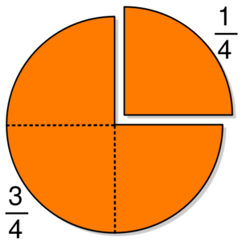
Fraction Fun!
By: Nancy Wilson

Slide 2
GLCEs
N.ME.02.18 Recognize, name, and represent commonly used unit fractions with denominators 12 or less; model 1/2, 1/3, and ¼ by folding strips.
N.ME.02.19 Recognize, name, and write commonly used fractions: 1/2 , 1/3 , 2/3 , 1/4 , 2/4 , 3/4 .

Slide 3
What is a fraction?
A fraction is a way to show how something is divided into equal parts.
1
2
2
3
3
4
6
7

Slide 4
Numerator
The numerator is the number on top of the fraction.
It tells you how many parts of the fraction are shaded in.
1
5
Numerator

Slide 5
Denominator
The denominator is the number on the bottom of the fraction.
The denominator shows how many total parts there are in the fraction.
1
5
Denominator

Slide 6
Quick Quiz
Click on the numerator.
4
5

Slide 7
Great Job!

Slide 8
Try
Again

Slide 9
Quick Quiz!
Click on the denominator
3
6

Slide 10
Great Job!

Slide 11
Try
Again

Slide 12
Examples of fractions
1
2
1 part shaded
2 parts all together
1
4

Slide 13
What fraction is shaded?
1
3
2
4

Slide 14
Try
Again

Slide 15
Great Job!

Slide 16
Which fraction is shaded?
3
4
1
4

Slide 17
Great Job!

Slide 18
Try
Again

Slide 19
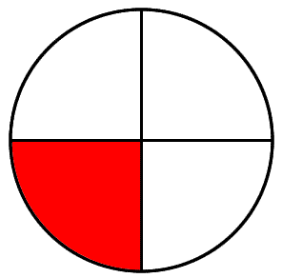
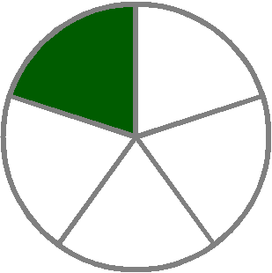
Which picture matches the fraction?
1
4

Slide 20
Great Job!

Slide 21
Try
Again

Slide 22
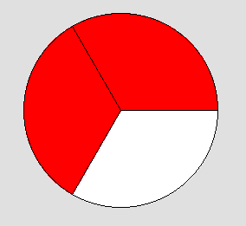
Which picture matches the fraction?
2
3

Slide 23
Great Job!

Slide 24
Try
Again

Slide 25
Great job learning about fractions!

